Slide 1

Data Engineering Class 3.2 Differences and Example
Carlos De Oliveira
(cnd279@NYU.edu)
Fall 2023

Slide 2
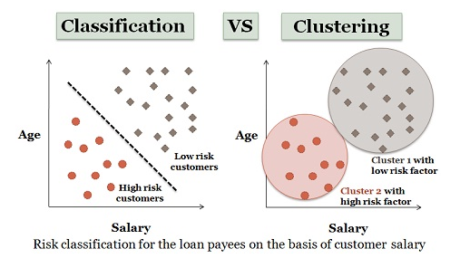
Classification and Clustering: Differences
Classification and Clustering are the two types of learning methods which characterize objects into groups by one or more features.
These processes appear to be similar, but there is a difference between them in context of data engineering.
The prior difference between classification and clustering is that classification is used in supervised learning technique where predefined labels are assigned to instances by properties, on the contrary, clustering is used in unsupervised learning where similar instances are grouped, based on their features or properties.
classification supervise label
clustering unsupervise lost meaning defination

Slide 3
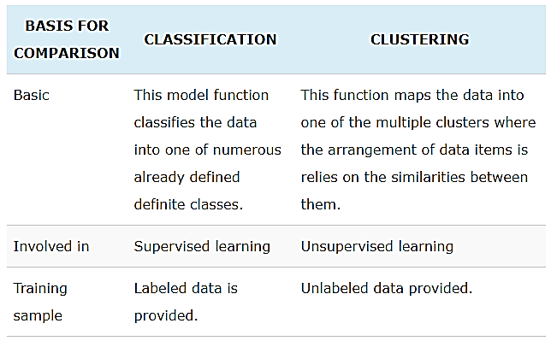
Comparison chart
missing value
wrong value
methodogy -- document
vwap - volume weighted average price
volatility & FD
1. organize cleaning
2. stat labeling data
3. pycaret for suggesting best module diff fx pair

Slide 4
Definition of classification
Classification is the process of learning a model that elucidate different predetermined classes of data. It is a two-step process, comprised of a learning step and a classification step. In learning step, a classification model is constructed, and classification step the constructed model is used to prefigure the class labels for given data.
For example, in a banking application, the customer who applies for a loan may be classified as a safe and risky according to his/her age and salary. This type of activity is also called supervised learning. The constructed model can be used to classify new data.

Slide 5
Definition of classification (cont.)
The learning step can be accomplished by using already defined training set of data. Each record in the training data is associated with an attribute referred to as a class label, that signifies which class the record belongs to. The produced model could be in the form of a decision tree or in a set of rules.
A decision tree is a graphical depiction of the interpretation of each class or classification rules. Regression is the special application of classification rules. Regression is useful when the value of a variable is predicted based on the tuple rather than mapping a tuple of data from a relation to a definite class. Some common classification algorithms are decision tree, neural networks, logistic regression, etc.

Slide 6
Definition of clustering: Differences
Clustering is a technique of organizing a group of data into classes and clusters where the objects reside inside a cluster will have high similarity and the objects of two clusters would be dissimilar to each other. Here the two clusters can be considered as disjoint. The main target of clustering is to divide the whole data into multiple clusters. Unlike classification process, here the class labels of objects are not known before, and clustering pertains to unsupervised learning.
In clustering, the similarity between two objects is measured by the similarity function where the distance between those two object is measured. Shorter the distance higher the similarity, conversely longer the distance higher the dissimilarity.
The tools mainly used in cluster analysis are k-mean, k-medoids, density based, hierarchical and several other methods.

Slide 7
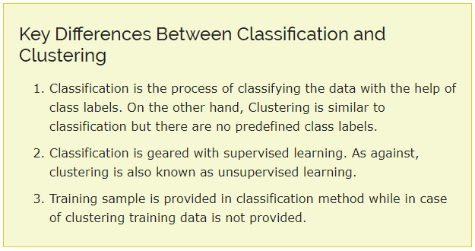
To keep in mind
Classification and clustering are the methods used for analyzing the data sets and divide them based on some classification rules or the association between objects.
Classification categorizes the data with the help of provided training data.
On the other hand, clustering uses different similarity measures to categorize the data.

Slide 8
Classification and Regression
Classification and Regression are two major prediction problems which are usually dealt in data engineering.
Predictive modelling is the technique of developing a model or function using the historic data to predict the new data.
The significant difference between Classification and Regression is that classification maps the input data object to some discrete labels.
On the other hand, regression maps the input data object to the continuous real values.

Slide 9
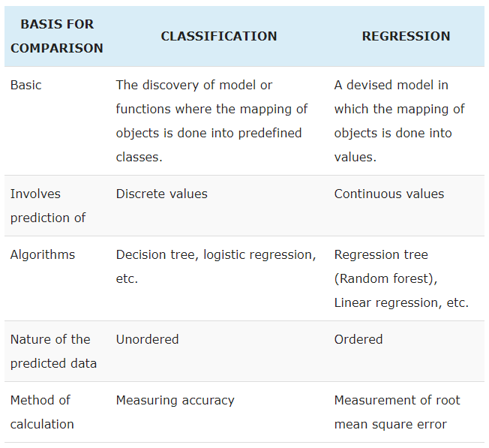
Comparison chart

Slide 10
Definition of regression
Definition of classification: see previous slide.
Regression is the process of finding a model or function for distinguishing the data into continuous real values instead of using classes. Mathematically, with a regression problem, one is trying to find the function approximation with the minimum error deviation. In regression, the data numeric dependency is predicted to distinguish it.
The Regression analysis is the statistical model which is used to predict the numeric data instead of labels. It can also identify the distribution movement depending on the available data or historic data.
Let’s take the similar example in regression also, where we are finding the possibility of rain in some regions with the help of some parameters. In this case, there is a probability associated with the rain. Here we are not classifying the regions within rain and no rain labels instead we are classifying them with their associated probability.

Slide 11
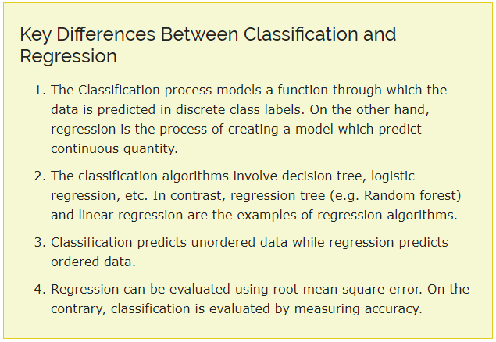

To keep in mind
Classification technique provides the predictive model or function which predicts the new data in discrete categories or labels with the help of the historic data.
Conversely, the regression method models continuous-valued functions which means it predicts the data in continuous numeric data.

Slide 12

Descriptive and Predictive DE: Differences
The descriptive and predictive data engineering techniques are used to find patterns.
The descriptive analysis provides the latest information on past or recent events.
On the other hand, predictive analysis answers future queries that move across using historical data as the chief decision principle.
In simple words, descriptive implicates discovering the patterns or associations relating to the data, whereas predictive involves predicting and classifying the behavior based on the current and past data.

Slide 13
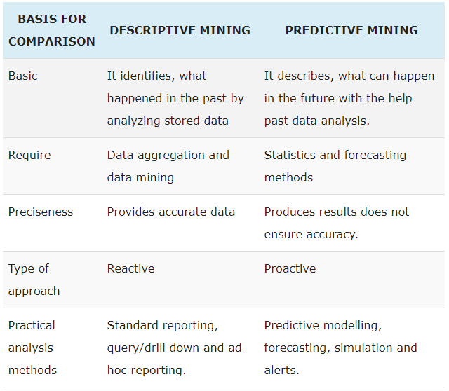
Comparison

Slide 14
Keep in mind
In general, descriptive DE employs unsupervised learning functions while predictive uses supervised learning techniques.
This is why descriptive DE cannot anticipate the unknown target values and focus on the intrinsic arrangement, interconnections, and relations.
Conversely, predictive DE specifies and distinguishes a data set for future prediction.

Slide 15
Q&A
The floor is open to your questions

